Slide 1
職場故事
(Animaze)

Slide 2
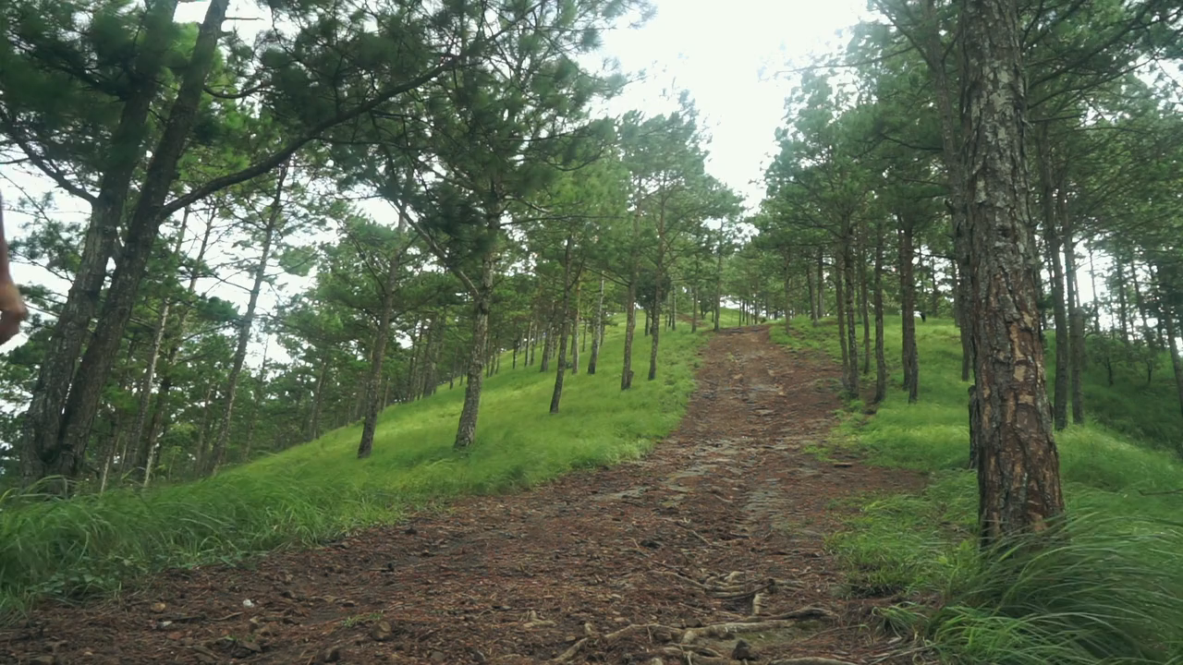
1.目標
Notes:
(https://pixabay.com/videos/man-hiker-forest-walk-camp-176780/)

Slide 3
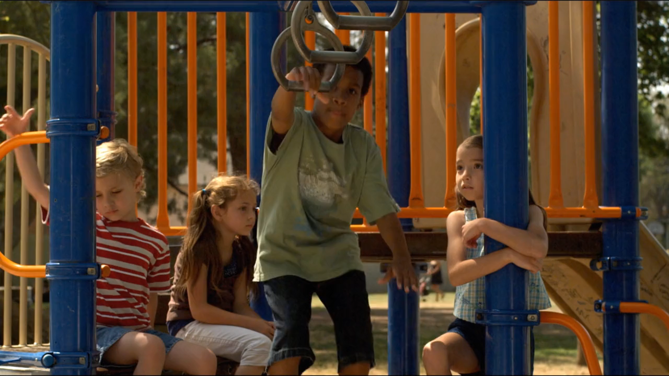
2.阻礙
Notes:
(https://pixabay.com/videos/children-playground-girl-boy-play-36724/)

Slide 4
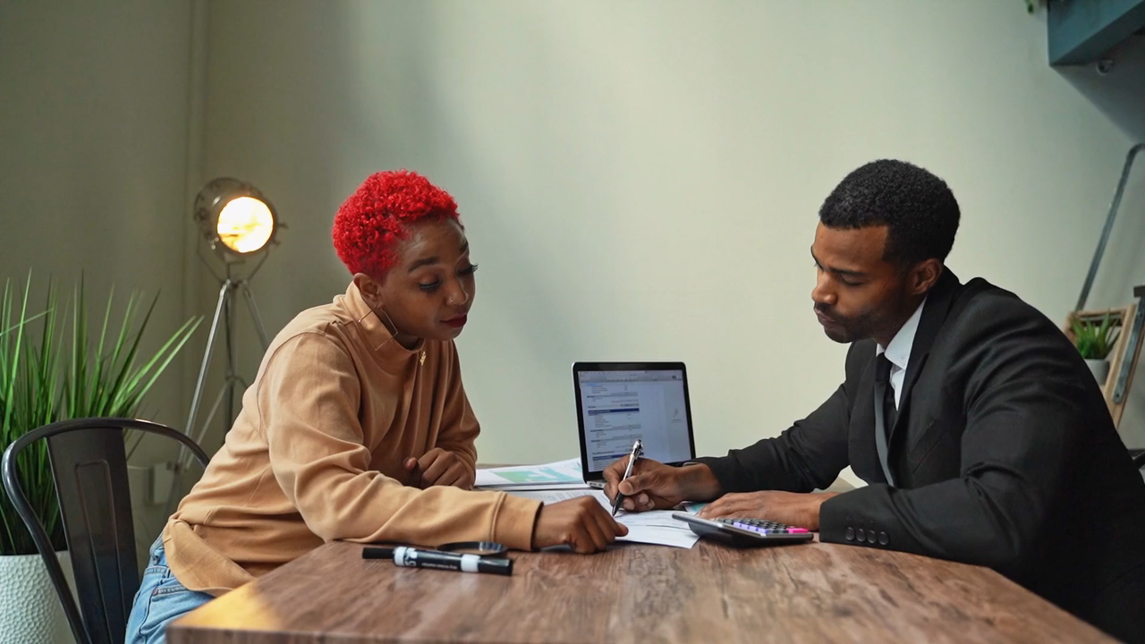
2.阻礙
Notes:
(https://pixabay.com/videos/office-desk-team-work-insurance-80314/)

Slide 5
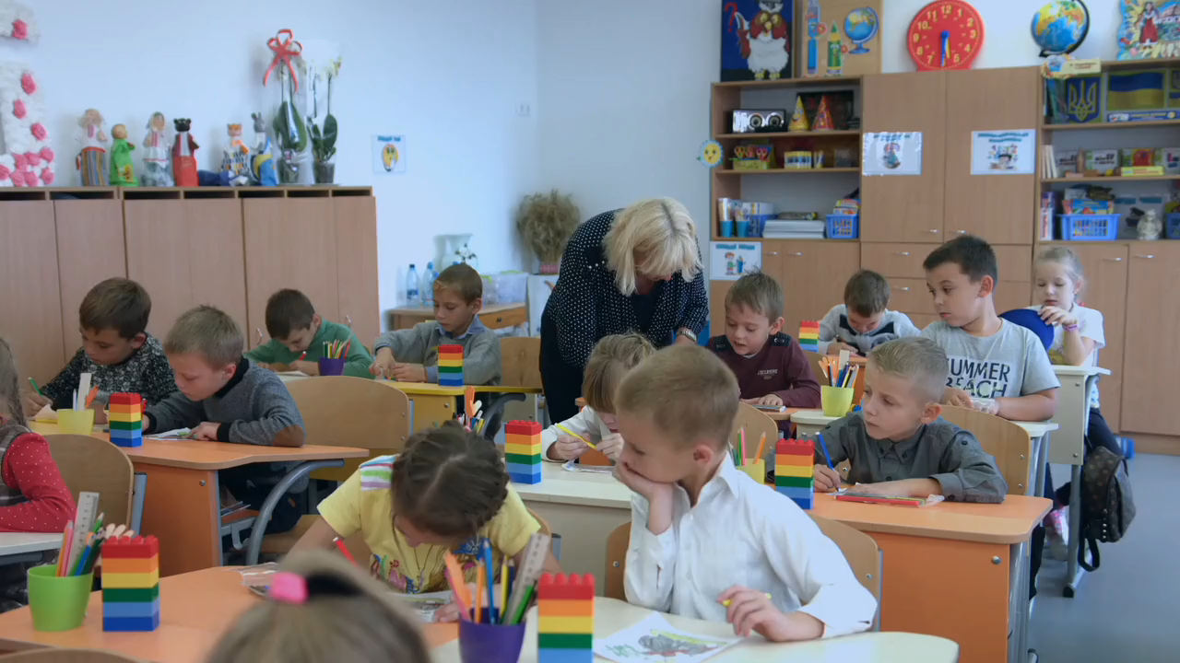
3.努力
Notes:
(https://pixabay.com/videos/school-kids-the-teacher-lesson-106705/)

Slide 6
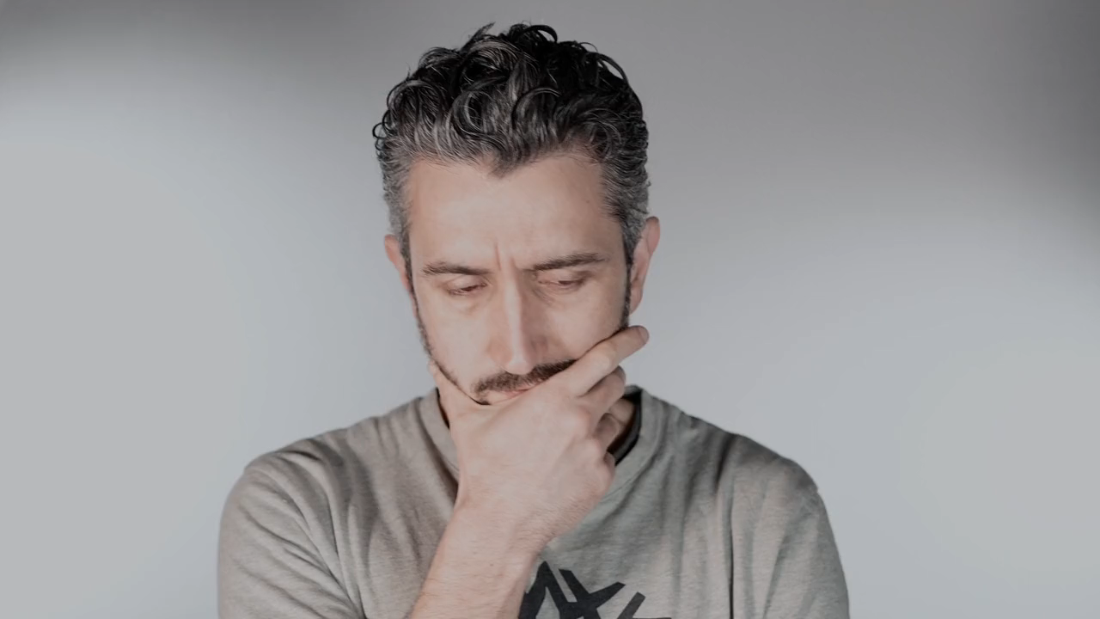
4.結果
Notes:
(https://pixabay.com/videos/man-think-beard-thoughtful-203251/)

Slide 7
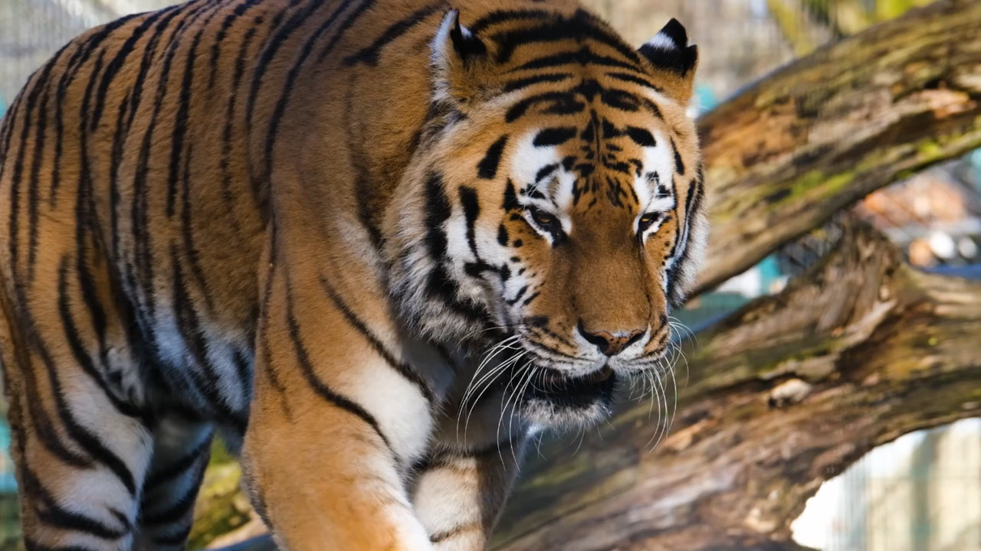
5.意外
Notes:
(https://pixabay.com/videos/tiger-predator-dangerous-carnivores-145320/)

Slide 8
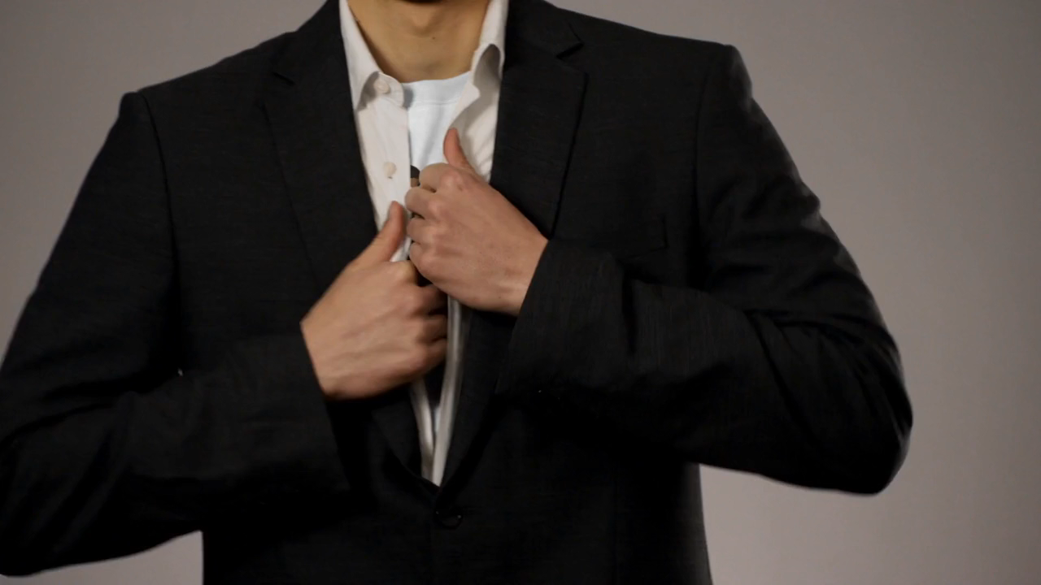
5.意外
Notes:
(https://pixabay.com/videos/hero-vest-man-strong-superman-64651/)

Slide 9
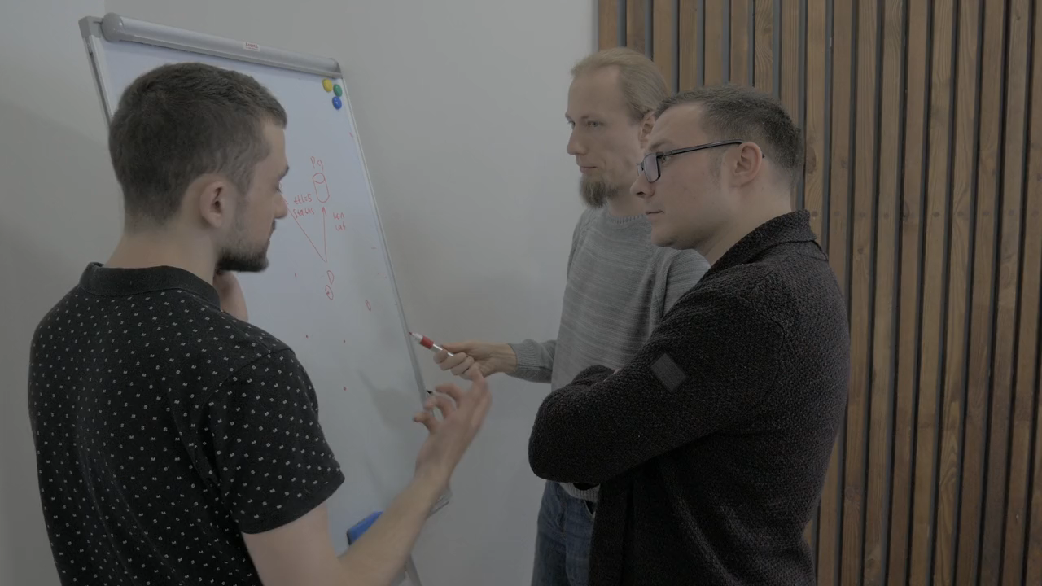
6.轉彎
Notes:
(https://pixabay.com/videos/office-business-contemporary-137265/)

Slide 10

6.轉彎
Notes:
(https://pixabay.com/videos/team-hands-group-together-106038/)

Slide 11
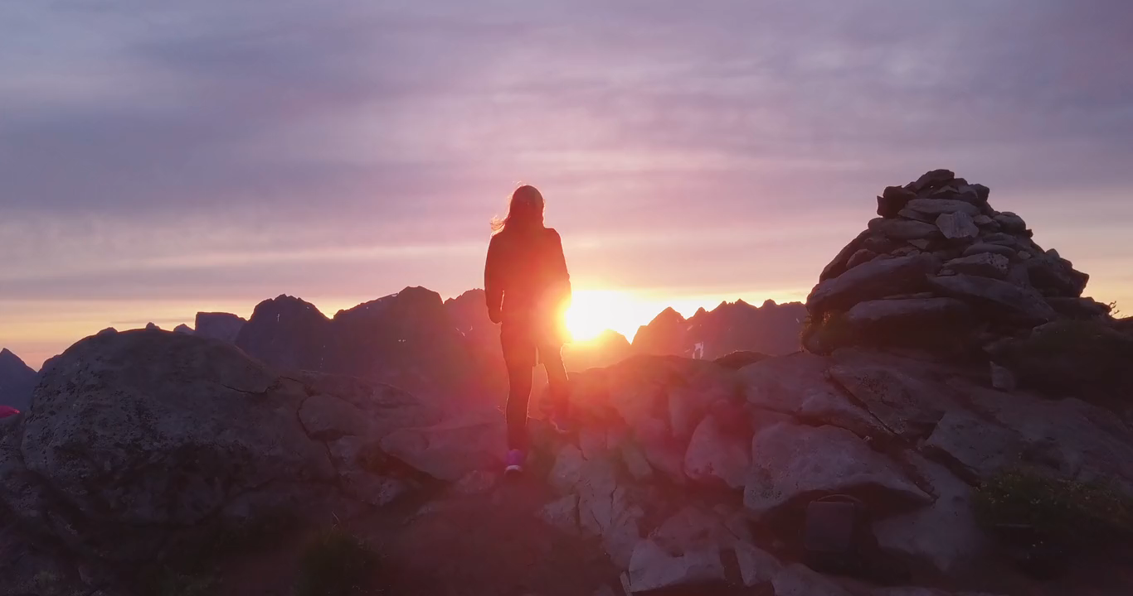
7.結局
Notes:
(https://pixabay.com/videos/woman-hike-peak-mountains-sunset-167582/)

Slide 12
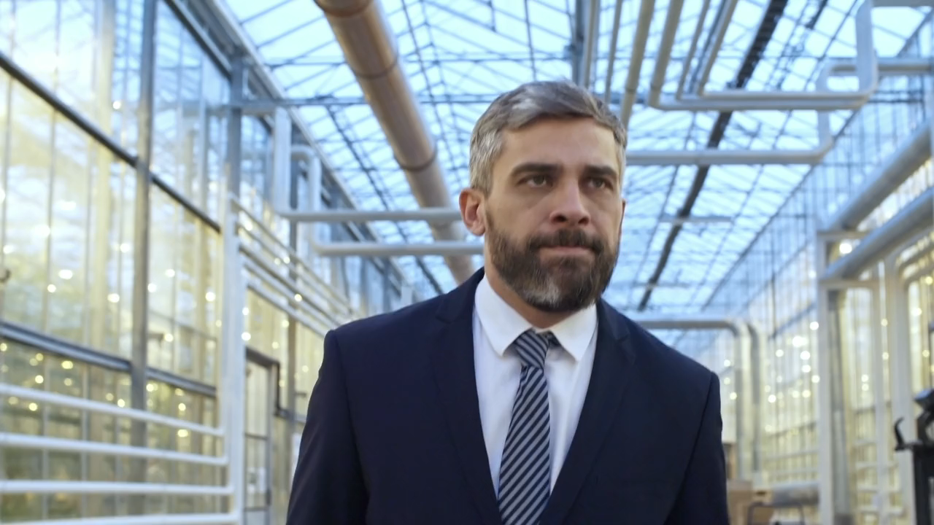
7.結局
Notes:
(https://pixabay.com/videos/man-walking-suit-business-office-199623/)

